Slide 1
Number System and Computer Arithmetic

Slide 2
Integer Representation
Integer
Signed
Unsigned
Sign and Magnitude
1’s Complement
2’s Complement

Slide 3
Computers uses a fixed number of bits to represent an integer.
The commonly-used bit-lengths for integers are 8-bit, 16-bit, 32-bit or 64-bit.
Besides bit-lengths, there are two representation schemes for integers:
Unsigned Integers: can represent zero and positive integers.
Signed Integers: can represent zero, positive and negative integers.
Three representation schemes had been proposed for signed integers:
Sign-Magnitude representation
1's Complement representation
2's Complement representation

Slide 4
Unsigned Integers
Unsigned integers can represent zero and positive integers, but not negative integers. An n-bit unsigned integer can represent integers from 0 to (2^n)-1
n= number of bits | Minimum | Maximum
8 | 0 | (2^8)-1 (=255)
16 | 0 | (2^16)-1 (=65,535)
32 | 0 | (2^32)-1 (=4,294,967,295) (9+ digits)
64 | 0 | (2^64)-1 (=18,446,744,073,709,551,615) (19+ digits)

Slide 5
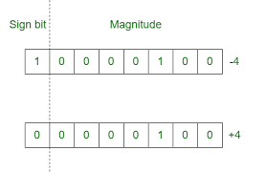
Signed Integers Sign Magnitude Representation
The most-significant bit (msb) is the sign bit,
0 representing positive integer
1 representing negative integer.
The remaining n-1 bits represents the magnitude (absolute value) of the integer.

Slide 6
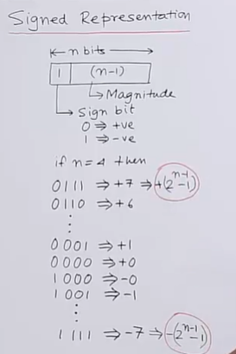
0 and -0 ?
This is not possible in number system.
so this is drawback of sign and magnitude representation method.
Therefore we use 2’s complement method to represent signed number

Slide 7
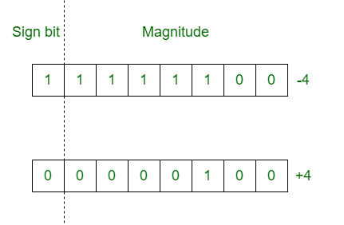
Signed Integers 1’s Complement Representation
Sign Bit | 1’s complement of actual binary

Slide 8
1’s Complement Representation
Can represent numbers from -32,767 to 32,767.
-215+1 .. 215-1
Arithmetic is easier than sign-magnitude.
But, still have two representations for zero:
0 = 00000000 00000000
-0 = 11111111 11111111

Slide 9
Signed Integers 2’s Complement Representation
Sign Bit | 2’s complement of actual binary

Slide 10
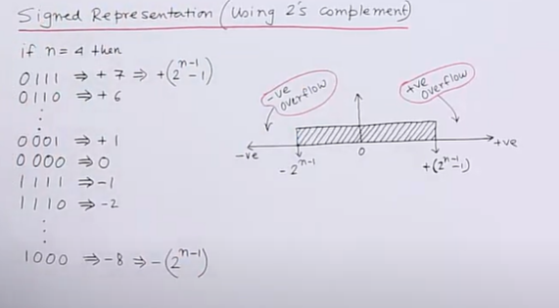
Signed Integers 2’s Complement Representation

Slide 11
Binary Addition
Input Bits |  | Sum | Carry
0 | 0 | 0 | 0
0 | 1 | 1 | 0
1 | 0 | 1 | 0
1 | 1 | 0 | 1
1+1+1=11
1+1+1+1=100

Slide 12
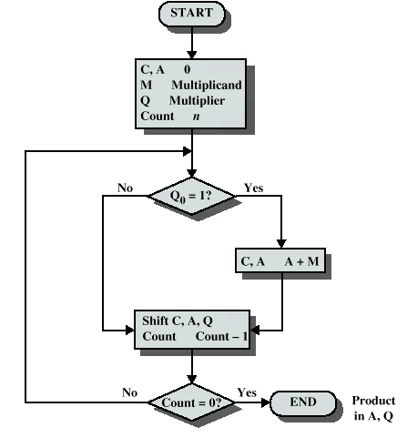
Unsigned Binary Multiplication

Slide 13
